Slide 1
Clinical Trails Science, Ants, and Eliza

Slide 2
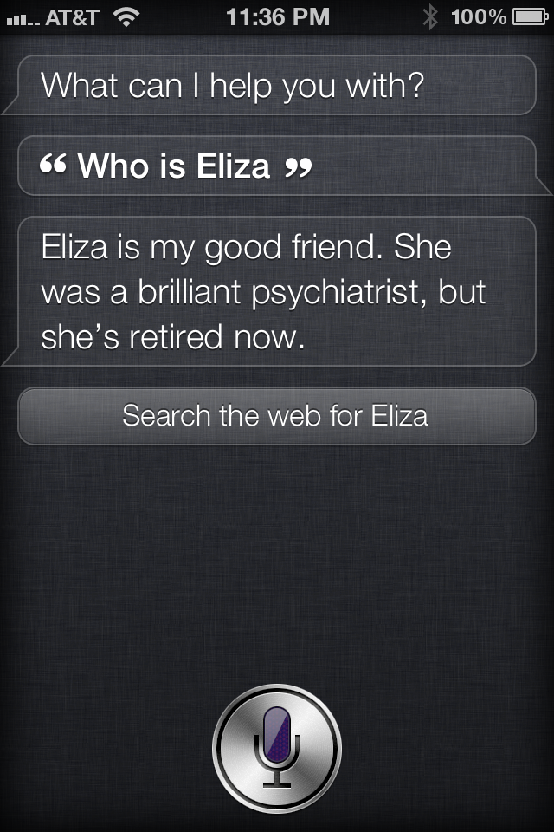
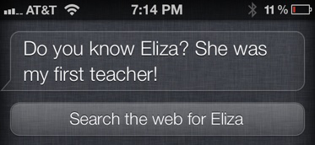

Slide 3
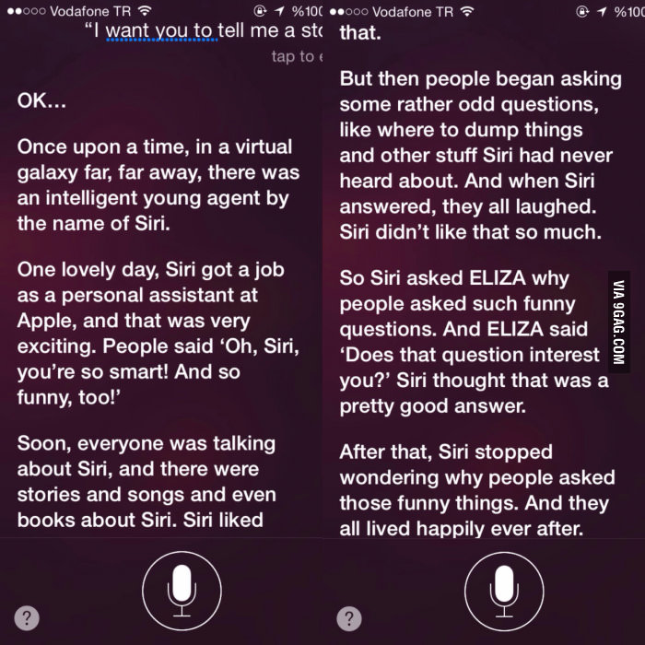

Slide 4
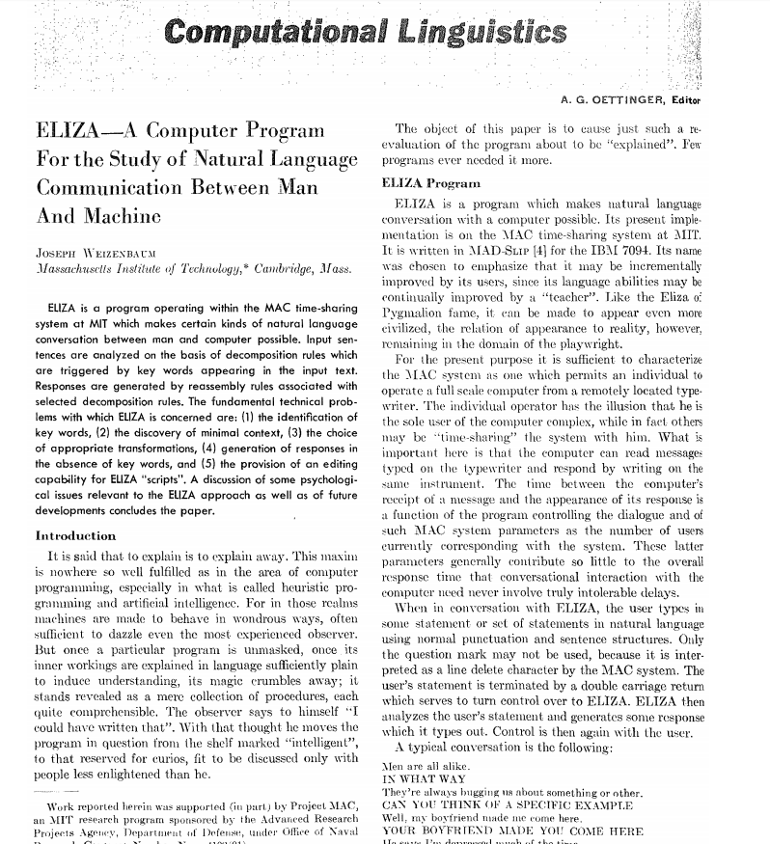

Slide 5
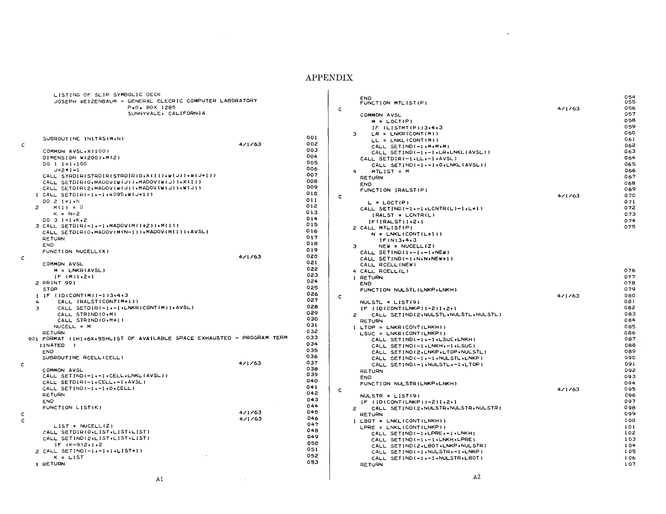

Slide 6
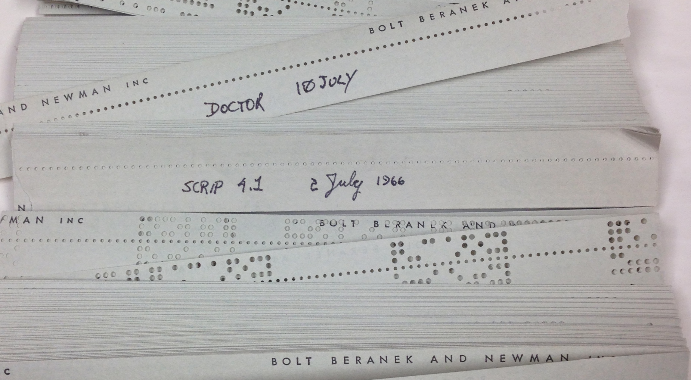

Slide 7
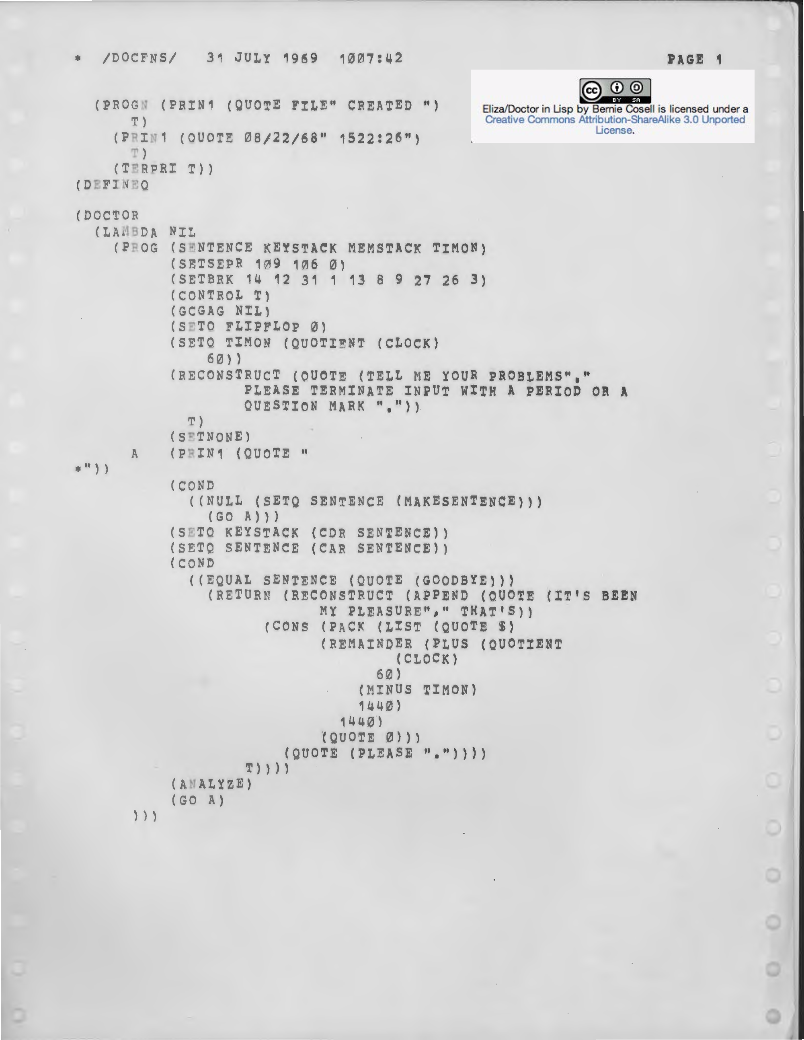

Slide 8
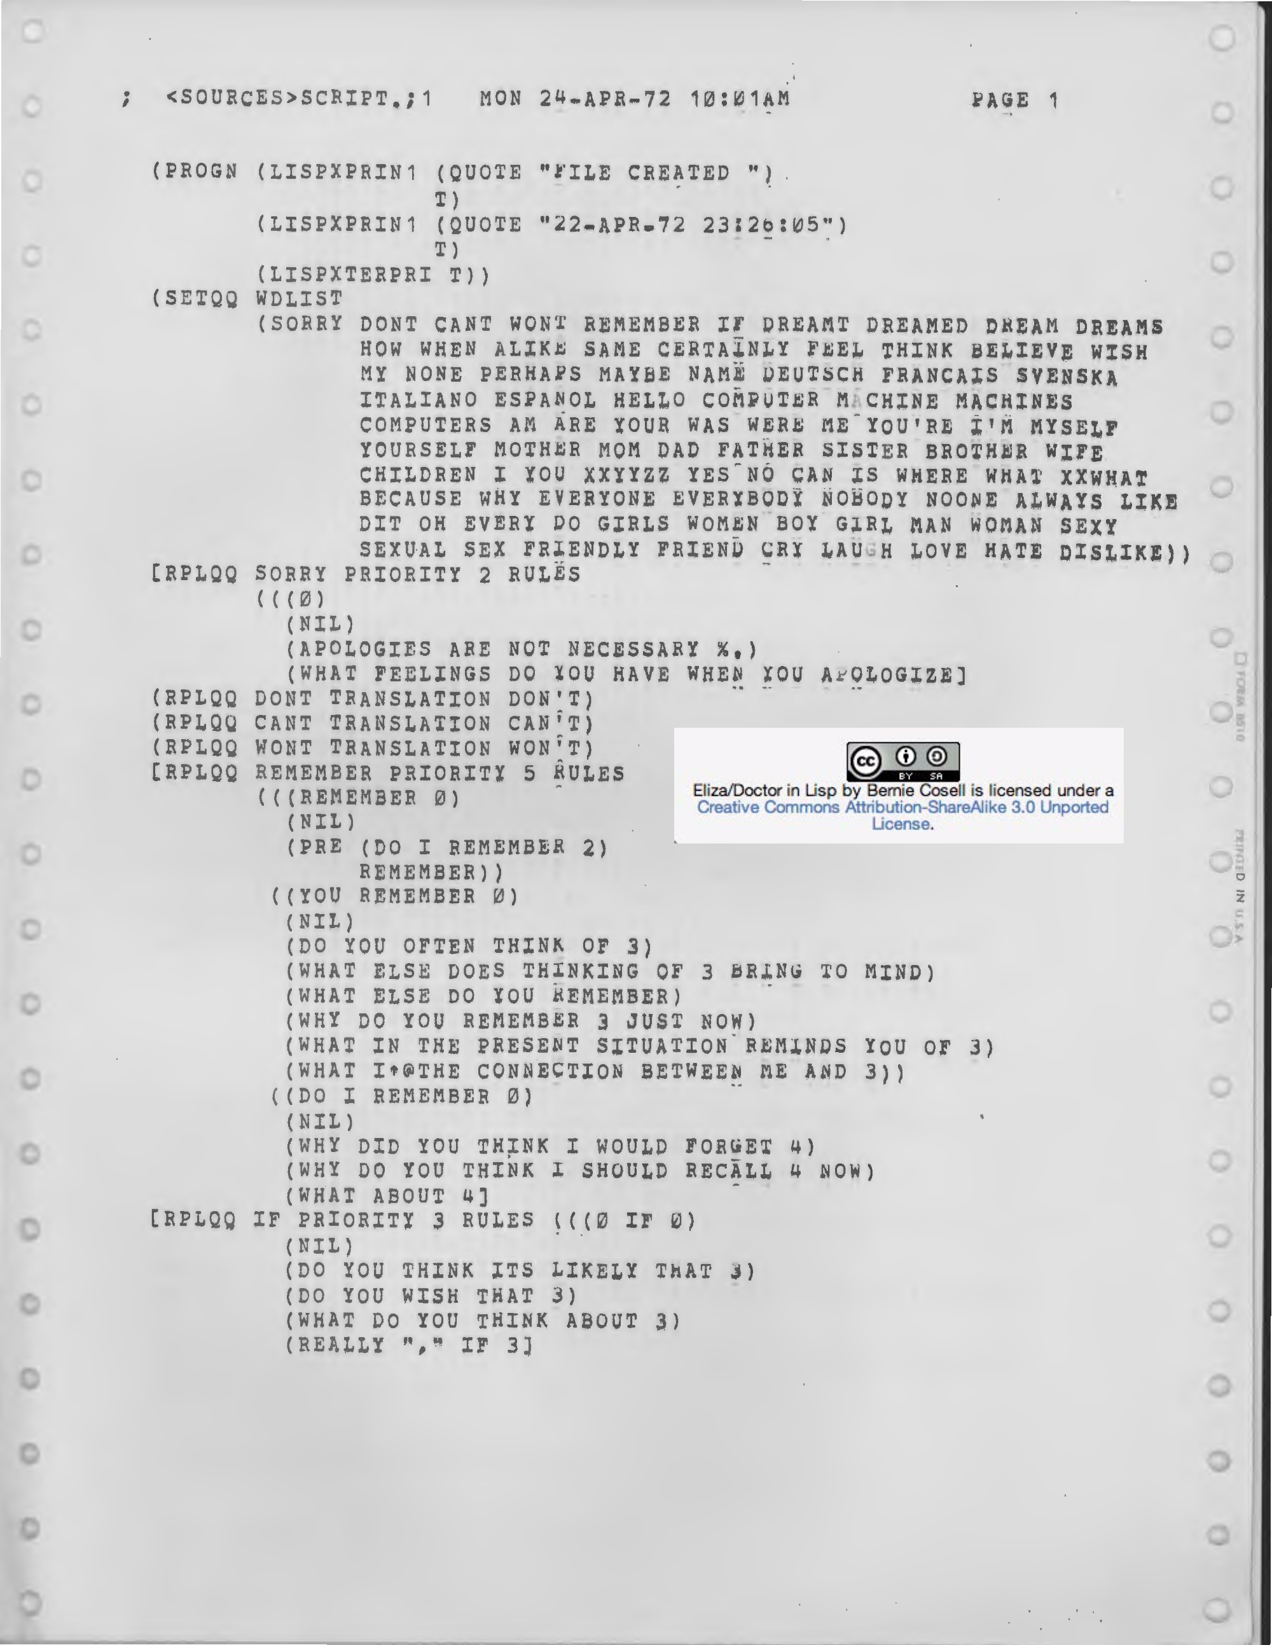

Slide 9
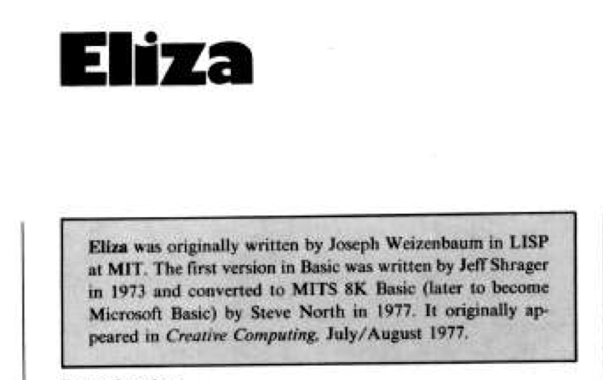

Slide 10
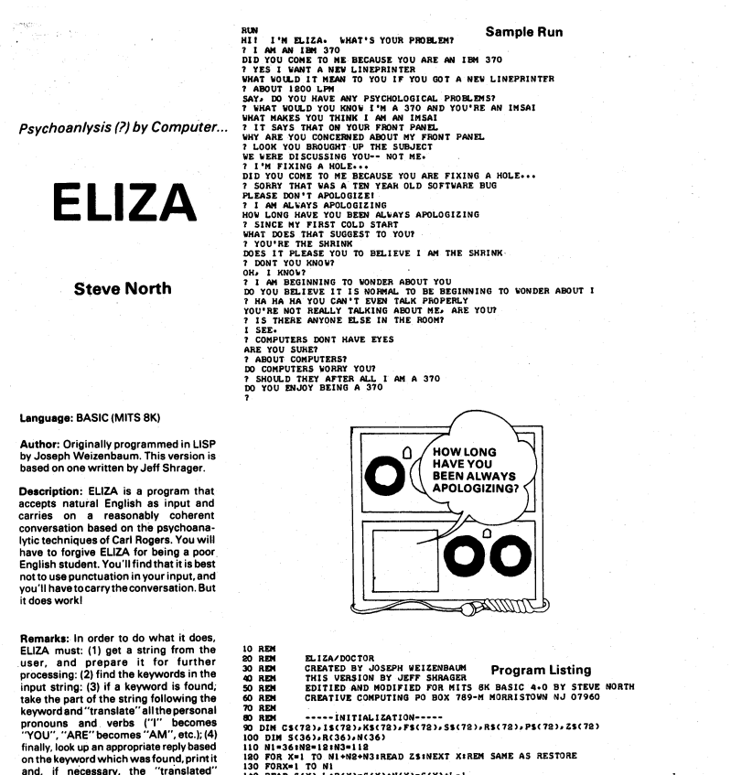

Slide 11
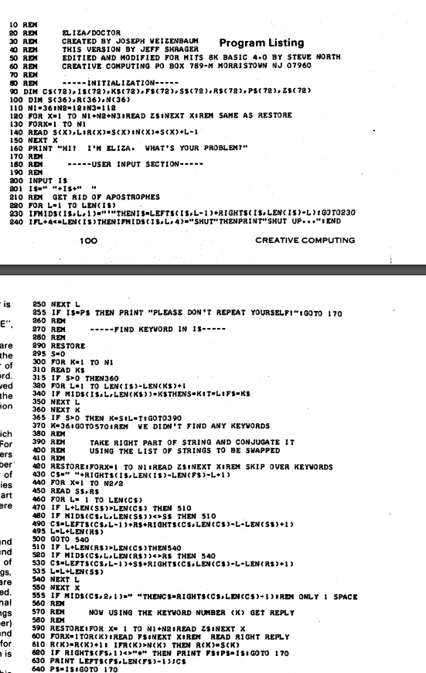

Slide 12
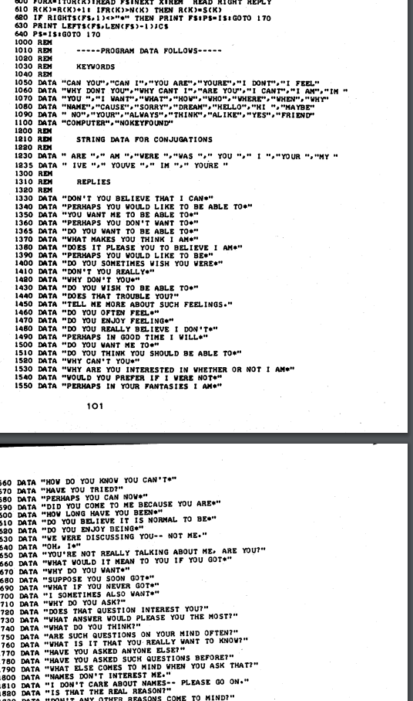

Slide 13
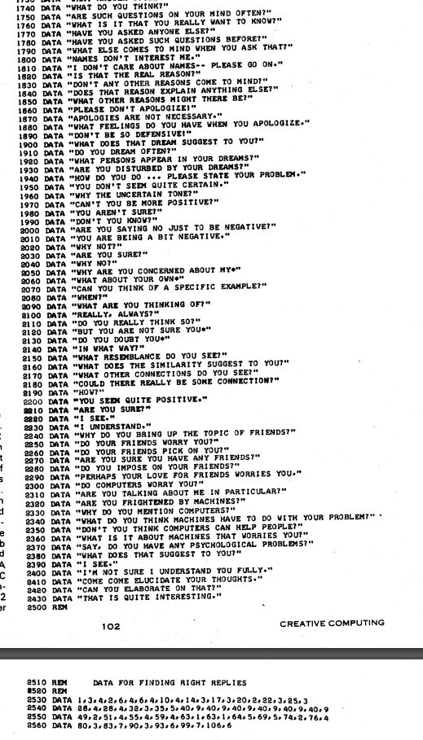

Slide 14
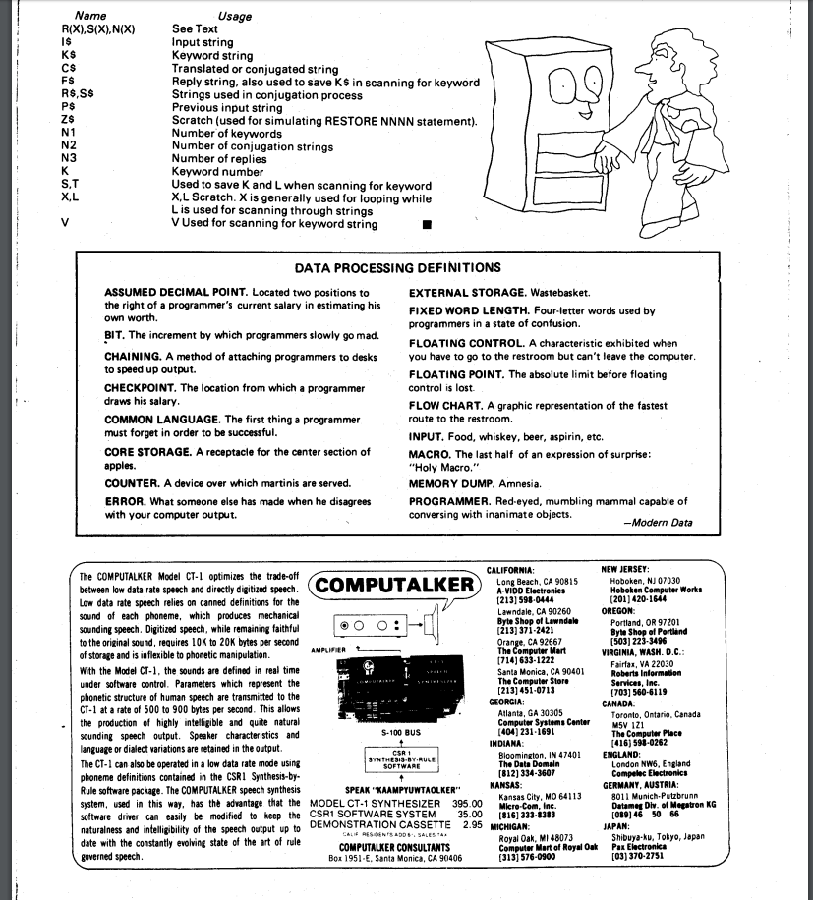

Slide 15
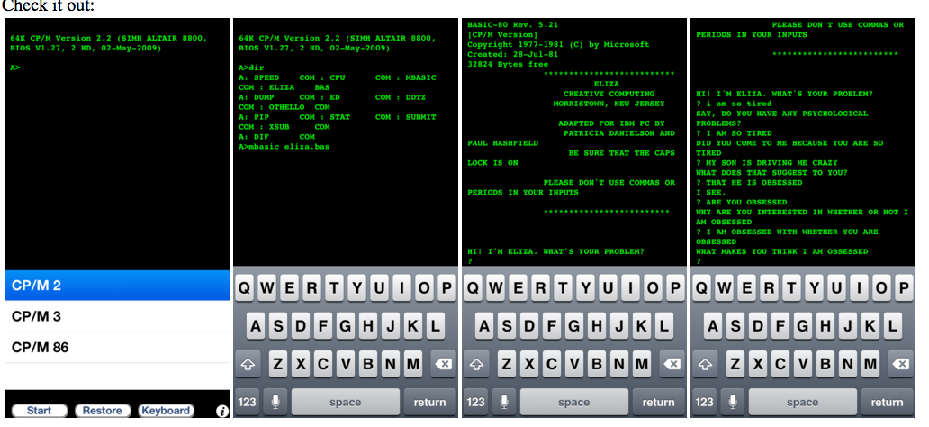

Slide 16
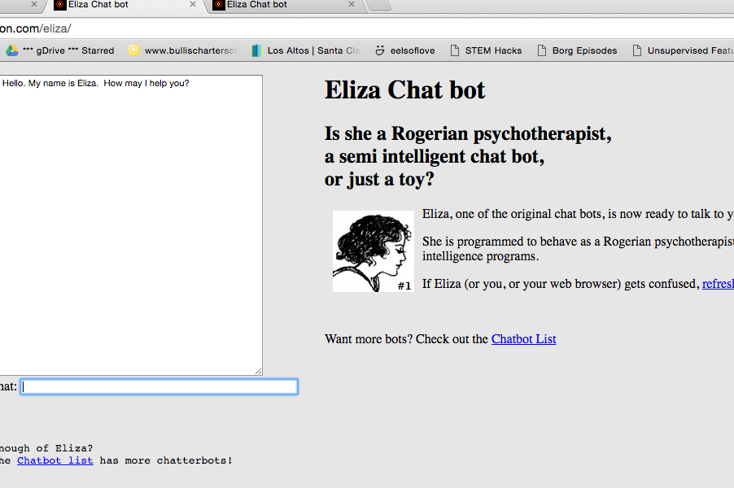

Slide 17
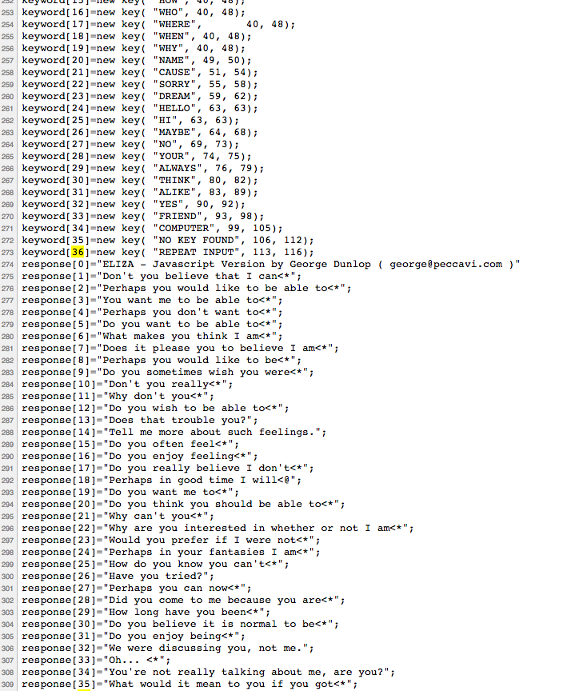

Slide 18
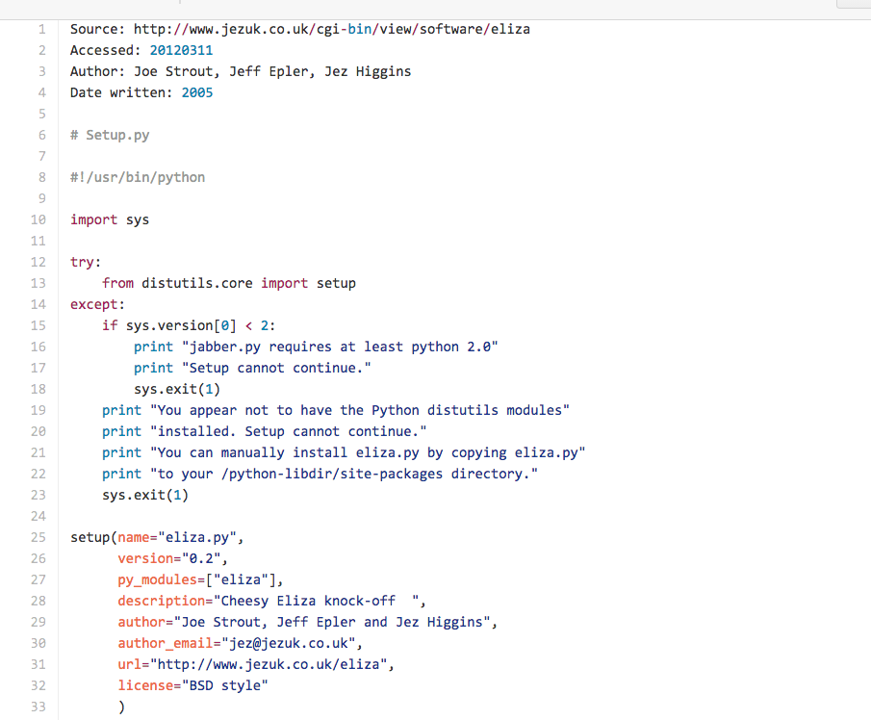

Slide 19
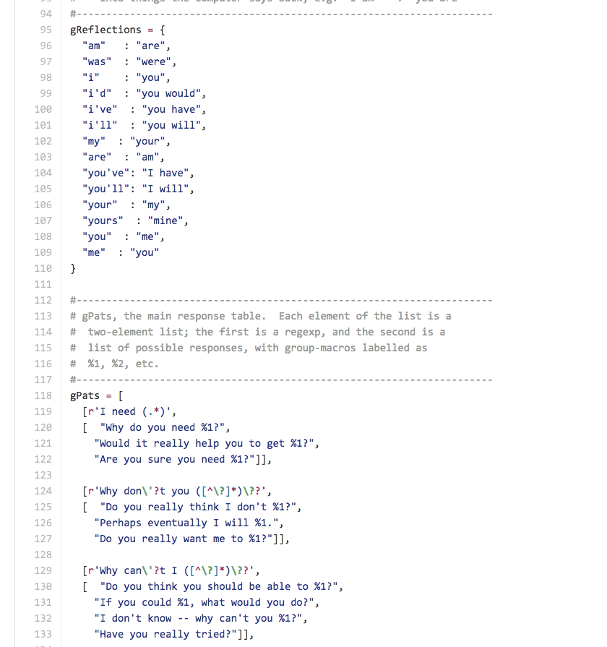

Slide 20
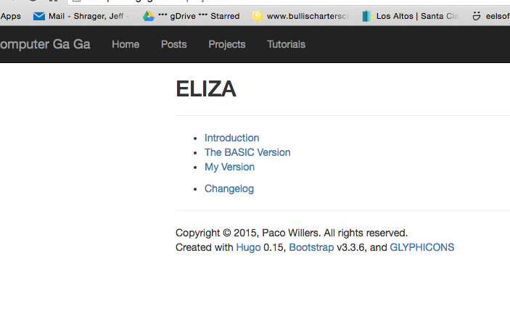

Slide 21
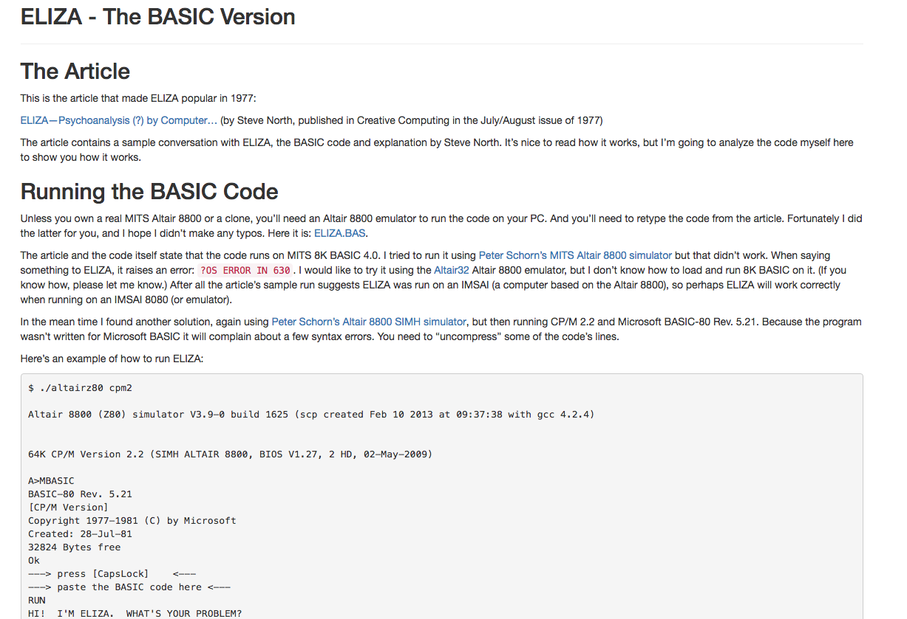

Slide 22
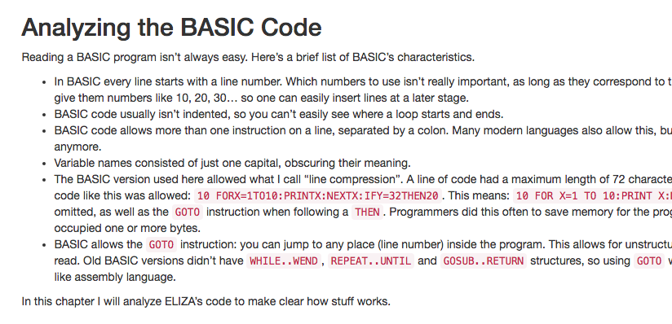

Slide 23
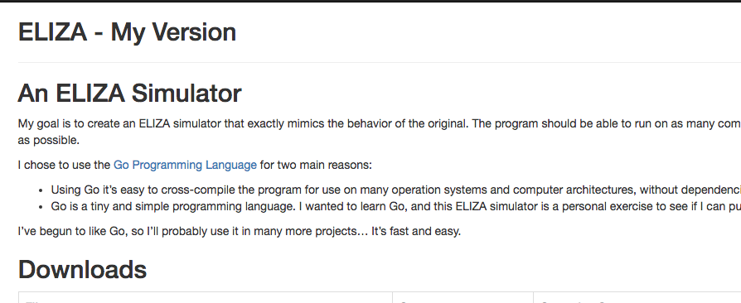

Slide 24


Slide 25
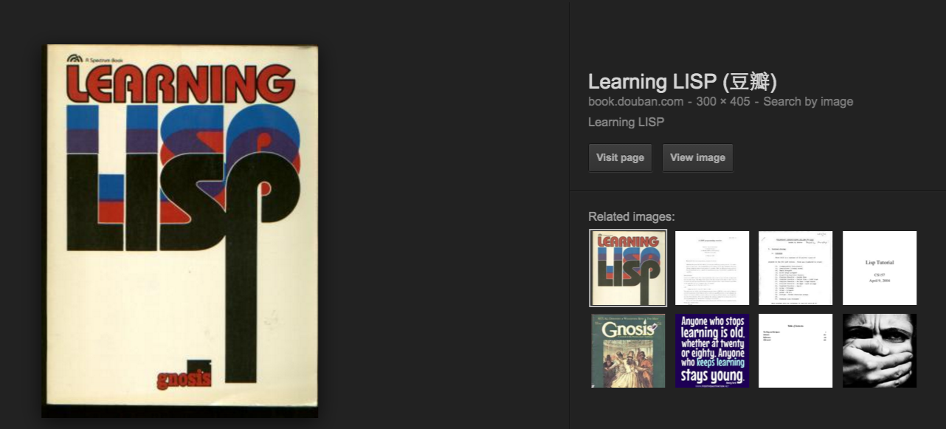

Slide 26
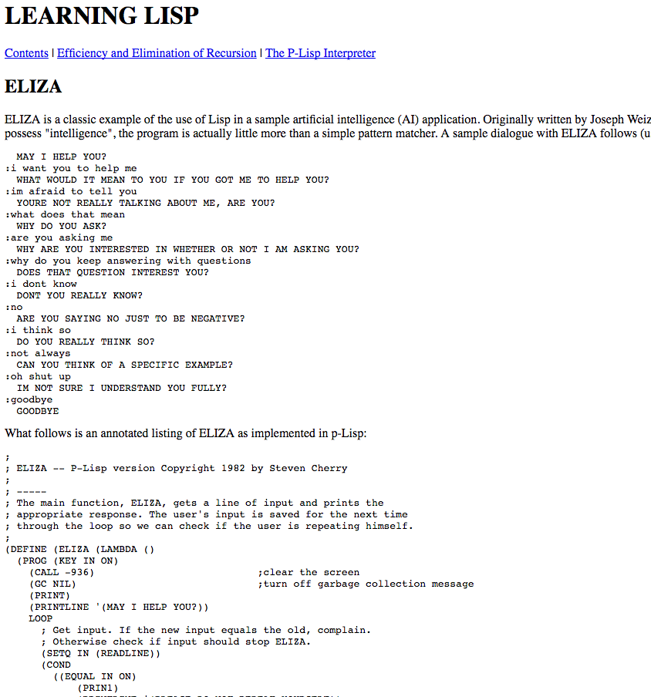

Slide 27
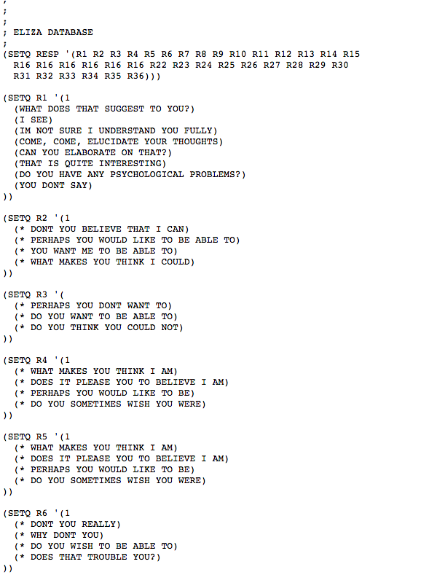

Slide 28
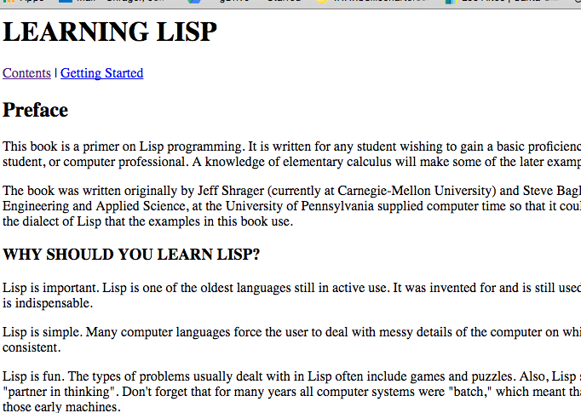

Slide 29
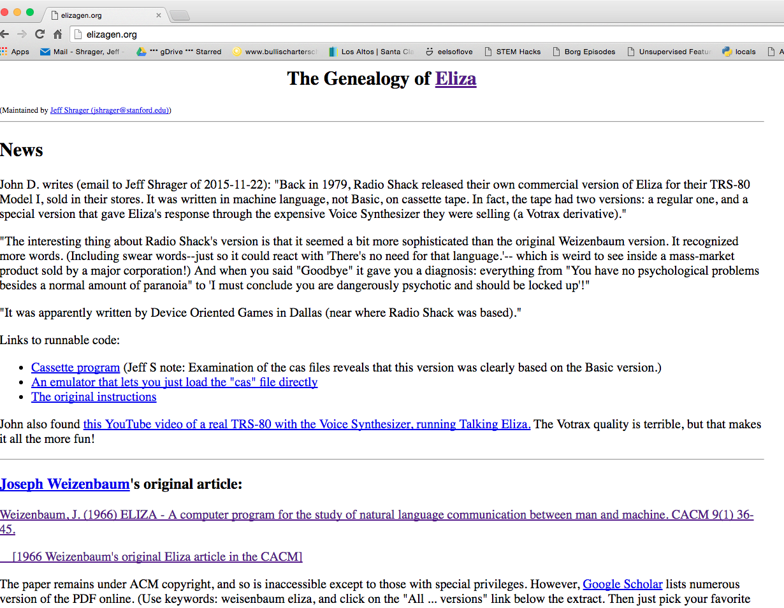

Slide 30
Pick a number
Difficulty isn’t just the nature of the algorithm, but the nature ot the possible algorithms in the problem domain

Slide 31
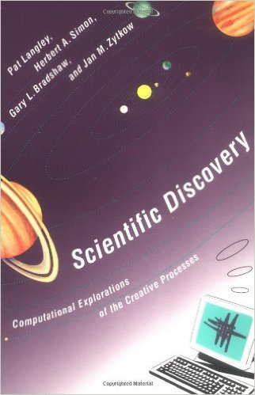

Slide 32
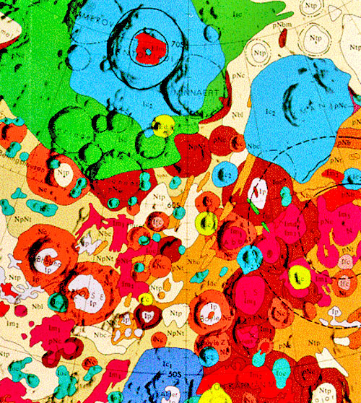
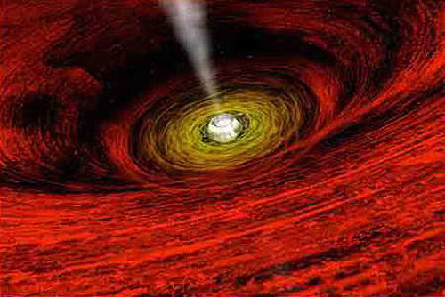
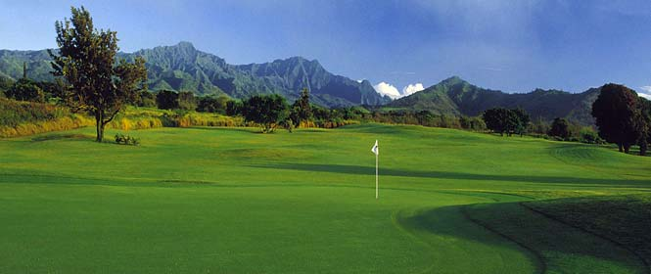

Slide 33
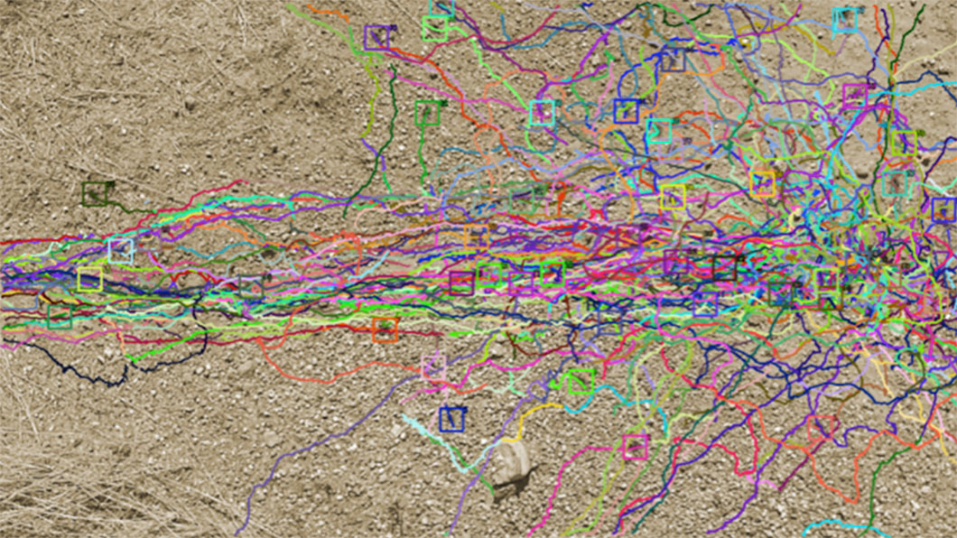
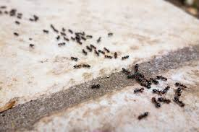
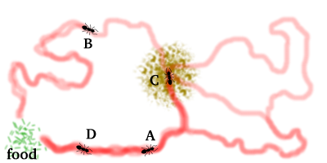

Slide 34
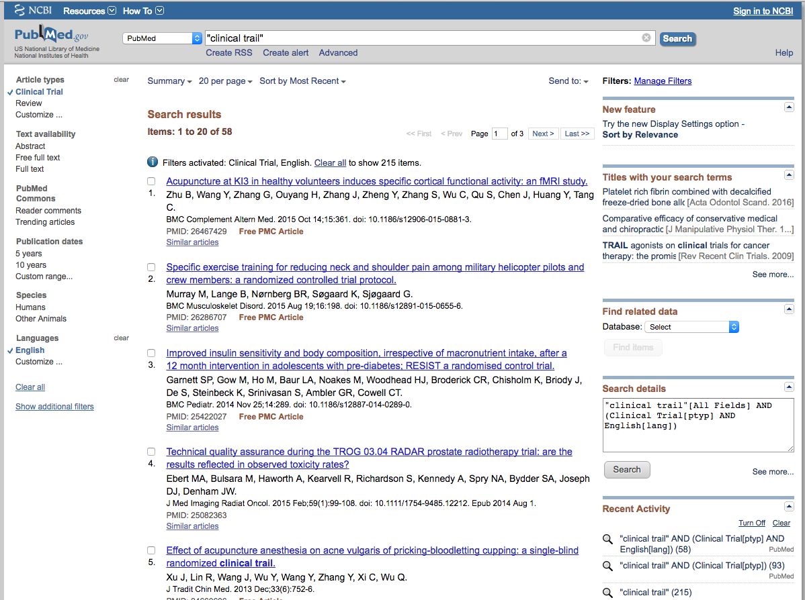

Slide 35
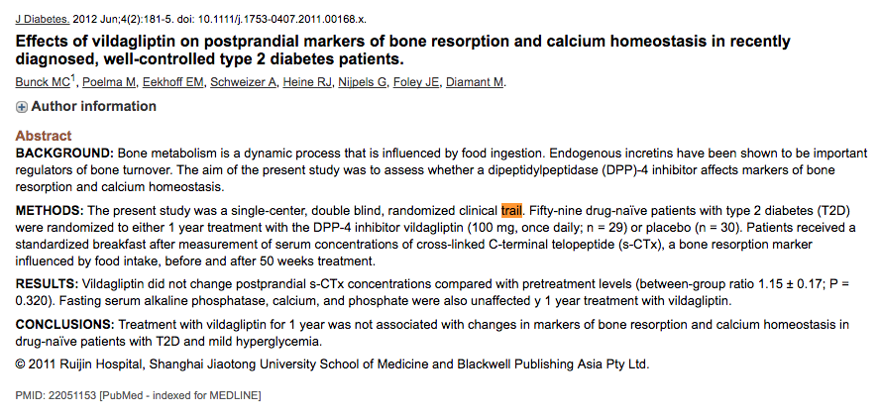

Slide 36
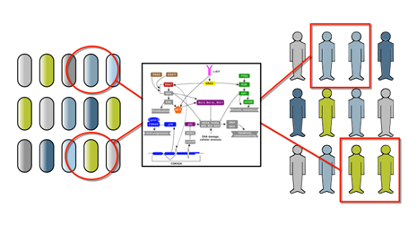
The decision problem: What to do to who, when?
Molecular Disease Model

Slide 37

Treatment Validation in the pre-OMIC Era
~100 cells
~1 Million patients/year
~10,000 patients/cell
Treatment selection was a statistical diagnosis problem: The diagnosis gave the treatment directly.
A handful of treatments
(chemo1, chemo2, etc.)
A handful of phenotypes
(lung, breast, etc.)

Slide 38
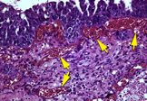
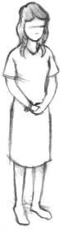

Pre-Omic Oncology Workflow
Biopsy
Biopsies
Monitor
Observations
Treatment
Treatment Selection
Patient
Treatment Planning
Adapted from NY Times
Notes:
We’re on the verge. Over the next 5 years, models and reasoning going to get a lot more sophisticated, and Big M essential.
(Looking ahead, 2020, but a few leaders like Tony are doing it today.)
Use of models, much deeper case reports, Essential role of Big M (no one can do this in their heads.
Emphasize role of models throughout: reverse engineering (small data), treatment planning (statistical chess – many games, with life and death stakes),
Robot scientist to test compounds (or propose)
Instantiation of reference models in Silicon Avatar.
Learning: Capture CRs from every patient. CC building a network to capture them.
In end, tight integration of research and care around individual patients.
Eliminate the artificial wall, and redefine what it means to do our best (using latest scientific knowledge, tools)
No daylight, Tony’s tumor board. (incredible to see real time science in ways it would never happen for a rat).
Califano – True story. ‘Who was that patient?’: potential to slash decades.
Double down if successful, else stop dead ends.
This is what Big M will make possible.
Nature paper -> PODT

Slide 39

Treatment Validation in the OMIC Era
10⁹ cells! (11^{z})
STILL ONLY A MILLION
PATIENTS/YEAR!
Approx. ZERO
patients/cell!
Thousands of treatments
(New drugs + combinations)
Treatment selection and planning are now reasoning problems, based upon huge amount of complex knowledge and data.
Millions of omic phenotypes (enormous feature vector!)

Slide 40
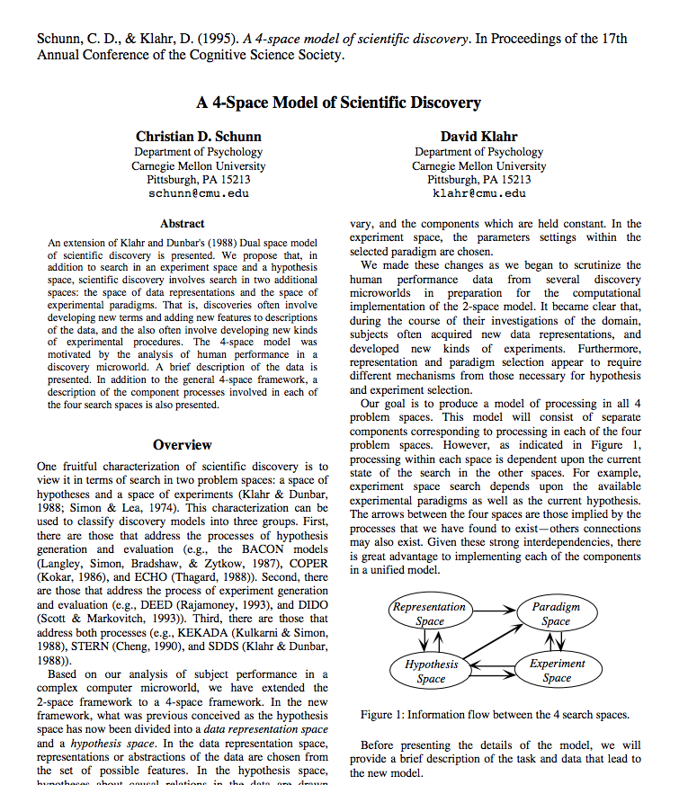
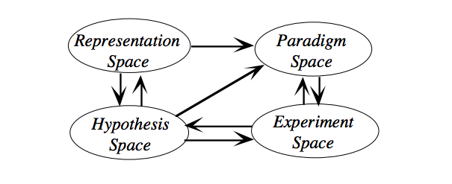

Slide 41
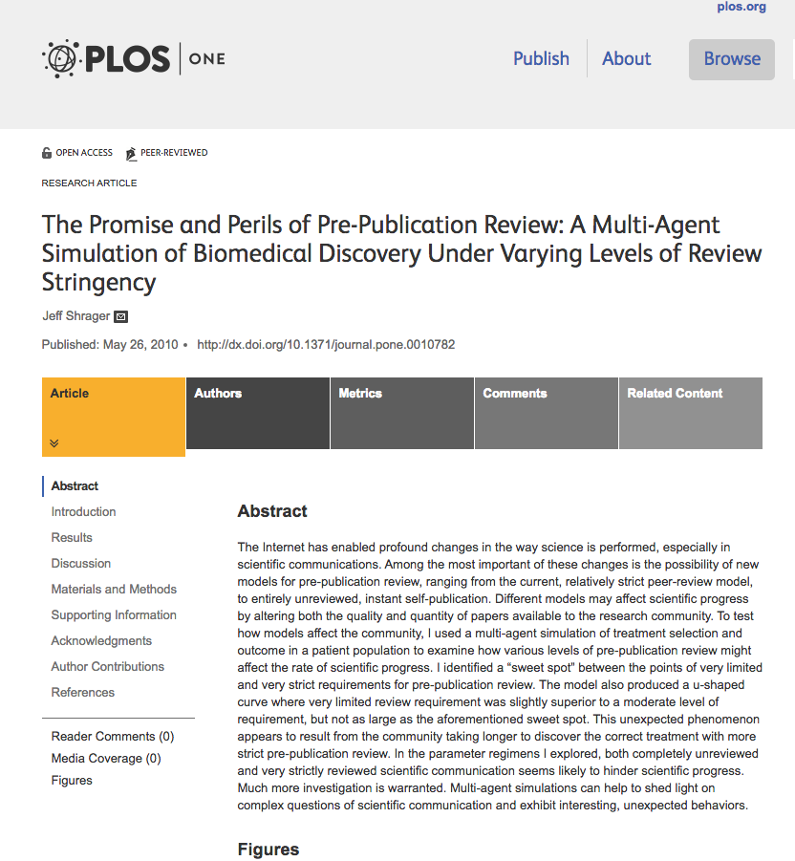

Slide 42
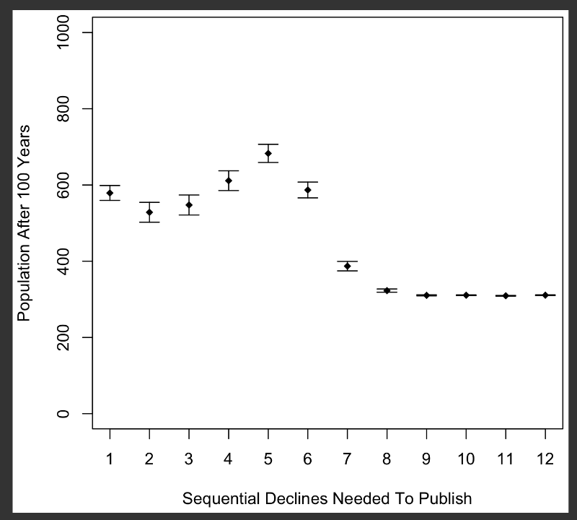

Slide 43
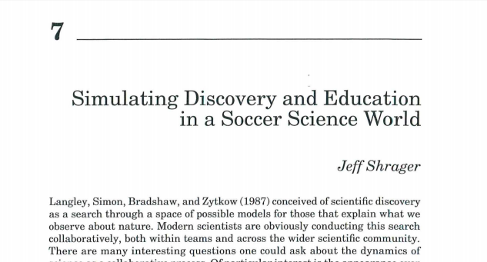

Slide 44
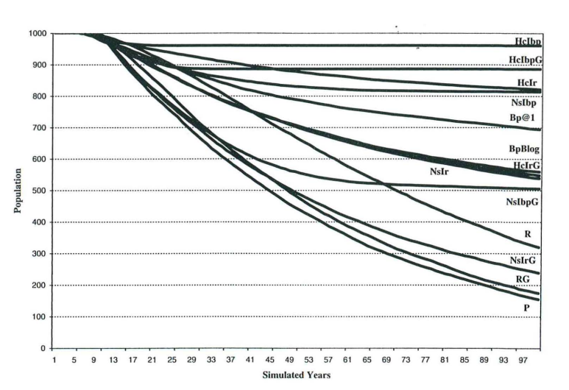

Slide 45
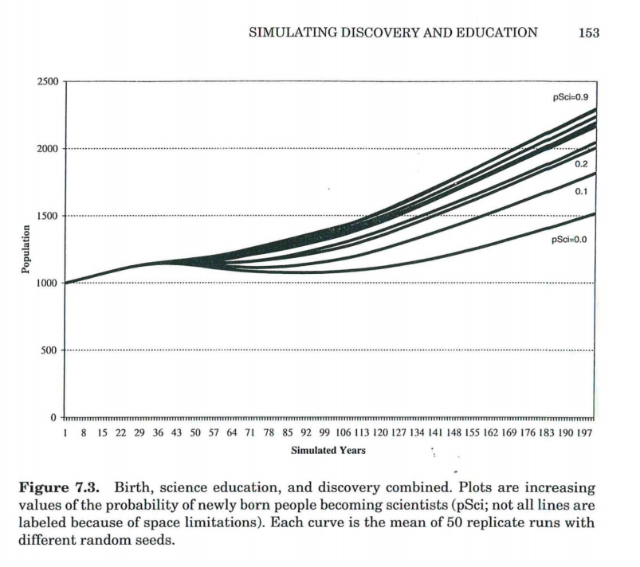

Slide 46
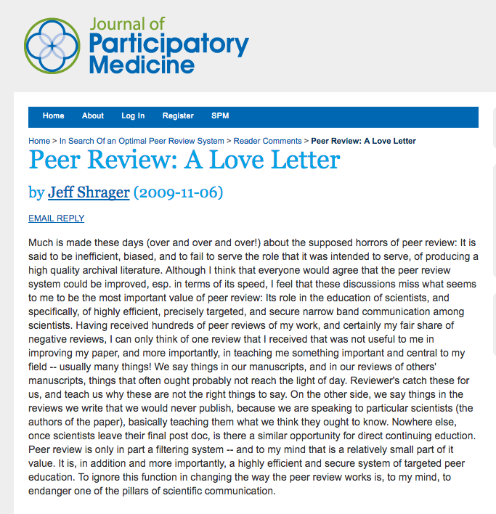

Slide 51
The decision problem: What to do to who, when?
Molecular Disease Model

Slide 52
Treatment Validation in the pre-OMIC Era
~100 cells
~1 Million patients/year
~10,000 patients/cell
Treatment selection was a statistical diagnosis problem: The diagnosis gave the treatment directly.
A handful of treatments
(chemo1, chemo2, etc.)
A handful of phenotypes
(lung, breast, etc.)

Slide 53
Pre-Omic Oncology Workflow
Biopsy
Biopsies
Monitor
Observations
Treatment
Treatment Selection
Patient
Treatment Planning
Adapted from NY Times
Notes:
We’re on the verge. Over the next 5 years, models and reasoning going to get a lot more sophisticated, and Big M essential.
(Looking ahead, 2020, but a few leaders like Tony are doing it today.)
Use of models, much deeper case reports, Essential role of Big M (no one can do this in their heads.
Emphasize role of models throughout: reverse engineering (small data), treatment planning (statistical chess – many games, with life and death stakes),
Robot scientist to test compounds (or propose)
Instantiation of reference models in Silicon Avatar.
Learning: Capture CRs from every patient. CC building a network to capture them.
In end, tight integration of research and care around individual patients.
Eliminate the artificial wall, and redefine what it means to do our best (using latest scientific knowledge, tools)
No daylight, Tony’s tumor board. (incredible to see real time science in ways it would never happen for a rat).
Califano – True story. ‘Who was that patient?’: potential to slash decades.
Double down if successful, else stop dead ends.
This is what Big M will make possible.
Nature paper -> PODT

Slide 54
Treatment Validation in the OMIC Era
10⁹ cells! (11^{z})
STILL ONLY A MILLION
PATIENTS/YEAR!
Approx. ZERO
patients/cell!
Thousands of treatments
(New drugs + combinations)
Treatment selection and planning are now reasoning problems, based upon huge amount of complex knowledge and data.
Millions of omic phenotypes (enormous feature vector!)

Slide 55
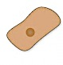

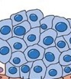











Precision Oncology Workflow
Scans
Normal skin cell
Original cancer cell
Biopsies
Serum Markers
Panomics
Biomarkers
Treated cell
Modeling and Targeting
Combo Therapies
Patient
Test
Treatment Planning
In vivo
In vitro
In silico
Notes:
We’re on the verge. Over the next 5 years, models and reasoning going to get a lot more sophisticated, and Big M essential.
(Looking ahead, 2020, but a few leaders like Tony are doing it today.)
Use of models, much deeper case reports, Essential role of Big M (no one can do this in their heads.
Emphasize role of models throughout: reverse engineering (small data), treatment planning (statistical chess – many games, with life and death stakes),
Robot scientist to test compounds (or propose)
Instantiation of reference models in Silicon Avatar.
Learning: Capture CRs from every patient. CC building a network to capture them.
In end, tight integration of research and care around individual patients.
Eliminate the artificial wall, and redefine what it means to do our best (using latest scientific knowledge, tools)
No daylight, Tony’s tumor board. (incredible to see real time science in ways it would never happen for a rat).
Califano – True story. ‘Who was that patient?’: potential to slash decades.
Double down if successful, else stop dead ends.
This is what Big M will make possible.
Nature paper -> PODT

Slide 56
Go
Jeopardy
(random factoids)
Cancer
Self-Driving Cars
Closed World
Closed World
(wikipedia)
Open World
Relatively Open World
Static rules
(for thousands of years)
Static Knowledge
(wikipedia)
Highly Dynamic (biology doesn’t change but everything else does)
Static rules
(for decades)
Simulation is
trivial
Simulation is un-necessary
Simulation is essentially impossible
Simulation isn’t
easy but
is possible
Experiments
are free
Experiments are un-necessary
Experiments aren’t just extremely expensive, but every experiment kills people or animals in horrible, painful ways!
Experiments are relatively in- expensive, but errors can kill!
Feedback is instantaneous
Feedback is instantaneous
Feedback can take years and is very noisy
Feedback is instantaneous and near perfect
Data is essentially unlimited
Data is essentially unlimited
Data is essentially
non-existent
Data is plentiful

Slide 57
Precision Oncology: Target Treatments to Patients Based on Molecular Disease Models (MDMs)
Clinical
History
Drug Availability and Affordability
Trial Practicalities
Guidelines
Dosing and Sequencing Details
Disease Model Predictions
Shared Decision
Making
Patient Preferences
Patient Education
Treatment
History
Tumor Availability for Testing
Financial Considerations

Slide 58
Simon’s Nth Heuristic: “Follow the Experts!”

Slide 59
Scans
Normal skin cell
Original cancer cell
Biopsy
Biopsies
Serum Markers
Panomics
Monitor
Sequence
Biomarkers
Treated cell
Combo Therapies
Treat
Modeling
Patient
Target
Test
Treatment Planning
In vivo
In vitro
In silico
Notes:
We’re on the verge. Over the next 5 years, models and reasoning going to get a lot more sophisticated, and Big M essential.
(Looking ahead, 2020, but a few leaders like Tony are doing it today.)
Use of models, much deeper case reports, Essential role of Big M (no one can do this in their heads.
Emphasize role of models throughout: reverse engineering (small data), treatment planning (statistical chess – many games, with life and death stakes),
Robot scientist to test compounds (or propose)
Instantiation of reference models in Silicon Avatar.
Learning: Capture CRs from every patient. CC building a network to capture them.
In end, tight integration of research and care around individual patients.
Eliminate the artificial wall, and redefine what it means to do our best (using latest scientific knowledge, tools)
No daylight, Tony’s tumor board. (incredible to see real time science in ways it would never happen for a rat).
Califano – True story. ‘Who was that patient?’: potential to slash decades.
Double down if successful, else stop dead ends.
This is what Big M will make possible.
Nature paper -> PODT

Slide 60



Molecular Tumor Board
Broad-based clinical experience:
Medical oncologists
Surgical oncologist Radiation oncologists
Other medical specialists
Biostatisticians
Radiologists
Pathologists
Clinical geneticists
Pathway experts
Pharmacologists
Oncological nurses
Reimbursement Admins
Computational Biologists
Notes:
All controlled by a molecular tumor board (or a single oncologist operating a tumor board). Unlike a traditional tumor board..
{Feature of these is MTB, a new type of advisory group comprised of multidisciplinary experts, including those in the fields of cancer biology, targeted therapies and bioinformatics, in addition to standard medical, surgical and radiation onologists, radiologists and pathologists”}
JOKE – which one is War Room?
{While they use the Web, No cancer informatics support}
Add Caption: medical, surgical and radiation therapy oncologists, biostatisticians, radiologists, pathologists, clinical geneticists, basic and translational science researchers, and bioinformatics and pathway analysis specialists .
Voiceover: Molecular Tumor Board, a new type of advisory group comprised of multidisciplinary experts, including those in the fields of tumor genetics, basic science and bioinformatics, in addition to standard medical, surgical and radiation onologists, radiologists and pathologists”
A second slide might have a map of the sites who are in line to be co-PIs (you have that list, just put their logos on a map of the US). You can adapt this one – some of the logos may already be there.
Analysis is done by new breed of tumor board – Molecular with experts on cancer biology, pathways, drugs, computational biology
It’s also increasingly virtual. And someday computerized and robot ‘scientists (foreshadowing)
Feature of both of these is Molecular tumor boards - have a scientist, do real time science, Tony Blau. (have two examples, guess which one).
“a new type of advisory group comprised of multidisciplinary experts, including those in the fields of tumor genetics, basic science and bioinformatics”
MMKS - We’re developing a platform – don’t have it yet, but not unlike patients – with all the data, evidence on demand. MMKS (pull up things on demand).
- needs to be virtual (everyone on Laptops is a better model?)
Maybe this goes later under Use Case 1.

Slide 61
Neither Data Mining nor Wide-Spread Expertise are Enough!
You must ACTIVELY control the search across the network of MTBs to optimize the treatment of, and value of patients!

Slide 62
MTB Workflow
Treatment Hypothesis Generation & Testing Cycles
Typical Clinical Workflow:
Patient
Recommended for MTB Process
Molecular Testing
MTB Meets
Patient & Care Team
Decide
Causal Mech.
Hyp-1
Hyp-2
-
Rx
Strategy
Opt-1
Opt-2
-
Decision
Line 1
Line 2
-
Case Summary

Slide 63
MTB trivially parallel Workflow
Treatment Hypothesis Generation & Testing Cycles
Typical Clinical Workflow:
Patient
Recommended for MTB Process
Molecular Testing
MTB Meets
Patient & Care Team
Decide
MTB Meets
Causal Mech.
Hyp-1
Hyp-2
-
Rx
Strategy
Opt-1
Opt-2
-
Decision
Line 1
Line 2
-
MTB Meets
Case Summary
MTB Meets
MTB Meets
MTB Meets
MTB Meets
MTB Meets
MTB Meets
MTB Meets
MTB Meets
MTB Meets
MTB Meets
MTB Meets
MTB Meets

Slide 64


Rapid Learning Precision Oncology
Notes:
{PartII – Other uses of Commons (knowledge, Expert Network, and Tools) – Deeper, at Scale. to generate hypotheses (small scalable)
What happens when solution possible but no one knows} (generate new K). Use map platform to go deep/transform system (map loop is step 1, Step 2 is RLPO3/ GCTA) – Xform research and care by tightly integrating around pts. Discuss RL PO 3.0, MTB; ecosystem.}. SEE NEXT NOTES SLIDE ON WHERE INSIGHTS FROM
High dimensional search. Must actively coordinate. AI problem.
When you hit the wall. On Map, Off map, mapping existing roads; adv pts = Building /mapping new roads. (New: capture data for common cancers, case reports for Nof1s)
Need to work with very best scientists and services as a team. Connect pts to docs, and capture the learnings.
Long term/short term – when it’s hardest cases. Requires PO 3.0, tumor board, EPOCH learning and GCTA.
(deal with the highest level of Cancer experts, learn and coordinate.).
Brief aside for science (future plan). Diseases x therapies too large a space, so all the cells are too sparse for big data.
Platform will accelerate research and care by tightly integrating them. GCTA
GCTA Every patient an ethical experiment, optimizing utilities, coordinated in a gigantic, continuous ongoing search for subtypes and treatments.
Exploration / Exploitation
Now building a network to capture case reports.

Slide 65


Global Cumulative Treatment Analysis (GCTA)
Exploration/Exploitation Tradeoff across all patient encounters
E/E Search Control
ArXiv 1308.1066, 2013
Nature Reviews Clinical Oncology, 2014

Slide 66

GCTA Coordinated Search
Treatment Hypothesis Generation & Testing Cycles
Typical Clinical Workflow:
Patient
Recommended for MTB Process
Molecular Testing
MTB Meets
MTB Meets
Causal Mech.
Hyp-1
Hyp-2
-
Rx
Strategy
Opt-1
Opt-2
-
MTB Meets
Case Summary
MTB Meets
MTB Meets
MTB Meets
MTB Meets
MTB Meets
MTB Meets
E/E Search Control
MTB Meets
MTB Meets
MTB Meets
MTB Meets
MTB Meets
MTB Meets

Slide 67



MTBs are literally engineering treatment plans for dying patients ... with NO TOOLS!!
“We gotta find a
way to make
this, fit into the
hole for this,
use’n nothin
but that.”

Slide 68
MTBs are engineering teams building treatment plans for dying patients...with NO TOOLS!
Broad-based clinical experience:
Medical oncologists
Surgical oncologist Radiation oncologists
Other medical specialists
Biostatisticians
Radiologists
Pathologists
Clinical geneticists
Pathway experts
Pharmacologists
Oncological nurses
Reimbursement Admins
Computational Biologists
Clinical
Course
The Patient
Therapeutic
Response
Tumor
Biology
Disease
Model

Slide 69
Typical Clinical Workflow
Treatment Hypothesis Generation & Testing Cycles
Patient
Recommended for MTB Process
Molecular Testing
MTB Meets
Patient & Care Team
Decide
Causal Mech.
Hyp-1
Hyp-2
-
Rx
Strategy
Opt-1
Opt-2
-
Decision
Line 1
Line 2
-
Case Summary
Reimbursement
Support Process

Slide 70
Precision Oncology: Target Treatments to Patients Based on Molecular Disease Models (MDMs)
Drug Availability and Affordability
Trial Practicalities
Guidelines
Dosing and Sequencing Details
Disease Model Predictions
Shared Decision
Making
Patient Preferences
Patient Education
Clinical
History
Tumor Availability for Testing
Treatment
History
Financial Considerations

Slide 71
Real MTB Report Out
Findings were discussed at the ITOMIC tumor board. It was mentioned that complete loss of BRCA1 heterozygous loss of CHEK2 might underlie the patient’s excellent response to Cisplatin, and might predict sensitivity to a Poly-ADP ribose polymerase (PARP) inhibitor (Fong et al., N Engl J Med 2009;361:123-134, Tutt et al., Lancet 2010;376:235-44; Somlo, San Antonio Breast Cancer Conference 2013). Since PARP inhibitors are investigational, it was recommended that the patient consider enrollment into a PARP inhibitor trial. The two FGFR2 missense mutations were also discussed. Patient's tumor has FGFR mis-sense mutations similar to S252W. The COSMIC database lists 44 endometrial cancers bearing the FGFR2(S252W) variant, and 4 endometrial cancers with FGFR2(Y375C). Neither mutation has been described previously in breast cancer. Of note a single COSMIC entry describes an endometrial cancer (1105632) bearing FGFR2(S252W;Y375C). Both variants occur within the ligand binding domain, and S252W expands the repertoire of ligands capable of activating FGFR2 (Greulich and Pollock, Trends Mol Med. 2011;17: doi:10.1016/j.molmed.2011.01.012, Dutt Proc Natl Acad Sci U S A 2008 PMID1855176, Yu et al. Proc Natl Acad Sci U S A. 2000 97:14536-41). ...
This example thanks to Tony Blau, University of Washington. Please do not reproduce or pass on without permission.

Slide 72
1. In Molecular Tumor Boards, cancer experts from many fields reason about the most difficult cases. 2. The goal of MTBs is explicitly to assemble a model of the disease process in the patient, based upon the best current knowledge, and then to reason from that model and everything known about the patient, to rank treatment options. 3. MTBs expose this knowledge and reasoning in their inputs, discussions, and reports. 4. MTB participants, being experts, use knowledge that is not available from the literature, nor from any other easily accessible source.

Slide 73
Kinds of knowledge unique to practice: (most conveniently accessible via MTBs) 1. What parts of the literature are too early? (too tentative to be useful in practice) 2. What parts of the literature are outdated? (no longer believed to be useful in practice) 3. Knowledge not available at all in the literature (e.g., ethical, political) 4. What are the importance relationships between the various knowledge elements? 5. How knowledge is interpreted in context of use? 6. In-context cross-domain translations/relations. 7. Assembly and explanation heuristics. (the “how to” of practical model-based reasoning)
SCIENTIFIC
PRAGMATICS

Slide 74
Kinds of knowledge unique to MTBs: 1. Arguments pro and con hypotheses. (Published case reports are highly sanitized and are written explicitly for educational purposes.) 2. Rationales for rejected hypotheses. (Often these never show up anywhere else!) 3. Explicit “insider” (unpublished) knowledge. (e.g., as above: too early, outdated, ethical, political, ...) 4. Implicit (unpublishable) knowledge relating to this particular sort of problem solving. 5. Stats on the sorts of cases that typically occur, and on the sorts of difficulties typically arise.
IN CONTEXT
KNOWLEDGE

Slide 75





What MTBs use and produce:
Data from actual molecular tumor board summary materials!
Notes:
MTB has a lot of information at their disposal as outlined in this Case Report.
Clinical history, scans, actionable molecular tumor alterations, and interpretations, containing detailed rationale.
Molecular models, but not computational (NOT LIVE) so only shallow reasoning is possible
(e.g., subtypes – limit to what docs can keep in their head, or ability to reason).
SHOW YOU A REAL ONE: Interpretation/RATIONALE IS IMPORTANT – captures their thinking, links to important, relevant publications and other evidence pro / con (read those). . …Pathway models are here, but not computational.
But with rare exceptions, so nothing’s learned, so patients are doomed to repeat
Use them to update the evidence review and model (which gets updated from time to time by experts, from the evidence review..)

Slide 76
For the hardest cases: a. Trajectories of disease model assembly processes. b. Highlighting of relevant evidence and gaps wrt and in background knowledge. c. Explanations (derivations /proofs) relating evidence to hypotheses. d. Hypotheses (and sometimes tests of them).
What MTBs produce
(MTBs discuss both pro and con reasoning for both accepted and rejected treatment hypotheses. Nowhere else is this available!)

Slide 77
Simon’s Nth+1 Heuristic: “Understand Expert Reasoning!”

Slide 78
Explanations
Treatment Regimens
Treatment Regimens
Explanations
Molecular Cohorts
Molecular Phenotypes

Slide 79
E.g., Probabilistic Explanation Based Generalization
Using cTRACS data to improve patient outcomes
(i.e., Causal Bayesian Network Induction)
Explanations
Treatment Regimens
Treatment Regimens
Explanations
Molecular Cohorts
Molecular Phenotypes

Slide 80







Norman: Semi-Automatic Guideline and Trial Updating
External Databases
(others…)
Critical Cases
Continuous
Tracking
External Experts
CollabRx Apps
Dynamic QA
and updating
Usage Data
CollabRx Models
App Platform
(Note that app inputs may
come through the UI, and/or
from EMRs, Sequencing, etc.)

Slide 81

Bayes Community ACH: Many Linked Local Analyses
Topics in Cognitive Science, 2009
Notes:
Think about how you would leverage the Commons (as a user or provider of services).
This is the future of drug development, and you need to decide if you’re going to part of it (or be frozen out).
Personalized, deep value for patients, and profitable.
---
More abstractly, an Internet scale K system, where everything is a source of knowledge or services to the other. KSs are M+M, Generates or tests hypotheses
Mobilize the worlds collective K and resources.
--
Lots of other things you can do with this platform (highlight to illustrate; make sure they relate to tapping CI)
--- many of you familiar, from talks given here on C1 Ecosystem
****DISTRIBUTED SEARCH ENGINE*** (maybe defer)
RUN TD or BU (orchestrate the ecosystem)
Innocentives (staff of 40,000 people on call, or contests) -- Collective Intelligence!
***Plug and play (reuse ecosystem) – manage workflows
Everyone can use it to build on each others processes.

Slide 82

Bayes Community ACH: Many Linked Local Analyses
Personalized Treatment Plan
Expert Opinion
(Published Knowledge)
Therapies
Disease Subtypes
Personal BioMarkers
uArray analyses of banked specimens
Topics in Cognitive Science, 2009

Slide 83
Select relevant background knowledge
S001 HISTORY
Subject 001 is a 45-year-old woman with metastatic TNBC*, originally diagnosed in January 2011 with Stage IIIA involvement of the left breast, who had failed multiple prior chemotherapy regimens by the time of study enrollment. Seven core needle biopsies of an enlarged right axillary lymph node, a left chest wall mass, and left pleural effusion.
* TNBC == Triple Negative Breast Cancer, i.e., absence of markers for sensitivity to estrogen, progesterone, and human epidermal growth factor receptors.
This example thanks to Tony Blau, University of Washington. Please do not reproduce or pass on without permission.

Slide 84
Select relevant background knowledge
S001 INTERPRETATION
Findings were discussed at the ITOMIC tumor board. It was mentioned that complete loss of BRCA1 heterozygous loss of CHEK2 might underlie the patient’s excellent response to Cisplatin, and might predict sensitivity to a Poly-ADP ribose polymerase (PARP) inhibitor (Fong et al., N Engl J Med 2009;361:123-134, Tutt et al., Lancet 2010;376:235-44; Somlo, San Antonio Breast Cancer Conference 2013). Since PARP inhibitors are investigational, it was recommended that the patient consider enrollment into a PARP inhibitor trial. The two FGFR2 missense mutations were also discussed. Patient's tumor has FGFR mis-sense mutations similar to S252W. The COSMIC database lists 44 endometrial cancers bearing the FGFR2(S252W) variant, and 4 endometrial cancers with FGFR2(Y375C). Neither mutation has been described previously in breast cancer. Of note a single COSMIC entry describes an endometrial cancer (1105632) bearing FGFR2(S252W;Y375C). Both variants occur within the ligand binding domain, and S252W expands the repertoire of ligands capable of activating FGFR2 (Greulich and Pollock, Trends Mol Med. 2011;17: doi:10.1016/j.molmed.2011.01.012, Dutt Proc Natl Acad Sci U S A 2008 PMID1855176, Yu et al. Proc Natl Acad Sci U S A. 2000 97:14536-41). ...
This example thanks to Tony Blau, University of Washington. Please do not reproduce or pass on without permission.

Slide 85
Assemble personalized cancer models
Explain the disease process
S001 INTERPRETATION
Findings were discussed at the ITOMIC tumor board. It was mentioned that complete loss of BRCA1 heterozygous loss of CHEK2 might underlie the patient’s excellent response to Cisplatin, and might predict sensitivity to a Poly-ADP ribose polymerase (PARP) inhibitor (Fong et al., N Engl J Med 2009;361:123-134, Tutt et al., Lancet 2010;376:235-44; Somlo, San Antonio Breast Cancer Conference 2013). Since PARP inhibitors are investigational, it was recommended that the patient consider enrollment into a PARP inhibitor trial. The two FGFR2 missense mutations were also discussed. Patient's tumor has FGFR mis-sense mutations similar to S252W. The COSMIC database lists 44 endometrial cancers bearing the FGFR2(S252W) variant, and 4 endometrial cancers with FGFR2(Y375C). Neither mutation has been described previously in breast cancer. Of note a single COSMIC entry describes an endometrial cancer (1105632) bearing FGFR2(S252W;Y375C). Both variants occur within the ligand binding domain, and S252W expands the repertoire of ligands capable of activating FGFR2 (Greulich and Pollock, Trends Mol Med. 2011;17: doi:10.1016/j.molmed.2011.01.012, Dutt Proc Natl Acad Sci U S A 2008 PMID1855176, Yu et al. Proc Natl Acad Sci U S A. 2000 97:14536-41). ...
This example thanks to Tony Blau, University of Washington. Please do not reproduce or pass on without permission.

Slide 86
Assemble personalized cancer models
Explain the disease process
S001 INTERPRETATION (continued)
... Subject 001’s tumor had a somatic frameshift insertion in BRCA1 with loss of heterozygosity (LOH), a heterozygous frameshift deletion in CHEK2, and two separate FGFR2 point mutations generating the variant FGFR2(S252W;Y375C), also with LOH. ... A cross-platform comparison of variant allele frequencies showed FGFR2(S252W;Y375C) levels to be disproportionately higher within the RNA-Seq dataset compared to UW-OncoPlex and WES, indicating that the variant allele is selectively expressed. Members of the ITOMIC Tumor Board predicted that the BRCA1 and CHEK2 mutations may confer susceptibility to PARP inhibitors. In considering the FGFR2 mutations members noted that while neither FGFR2 variant had been reported previously in breast cancer, the COSMIC database contained multiple cases of endometrial cancer associated with each variant individually, and a single case of endometrial cancer in which both S252W and Y375C occurred together. Collectively, these results suggested that FGFR2(S252W;Y375C) may be a driver of tumor growth.
This example thanks to Tony Blau, University of Washington. Please do not reproduce or pass on without permission.

Slide 87
Create and test treatment plans
S001 INTERPRETATION (continued)
...Both native FGFR2 and the p.S252W variant are susceptible to inhibition by the investigational drugs Dovitinib (Konecny GE, et al. Mol Cancer Ther. 2013;12:632-42) and NVP-BGJ398 (Guagnano et al. Cancer Discov. 2:1118-33, 2012 PMID: 23002168), and the approved drug, Ponatinib (Gozgit et al. Cancer Research: April 15, 2011; Volume 71, Issue 8, Supplement 1) Hypothesize Dovitinib treatment. Subject 001’s tumor had a somatic frameshift insertion in BRCA1 with loss of heterozygosity (LOH), a heterozygous frameshift deletion in CHEK2, and two separate FGFR2 point mutations generating the variant FGFR2(S252W;Y375C), also with LOH. ... A cross-platform comparison of variant allele frequencies showed FGFR2(S252W;Y375C) levels to be disproportionately higher within the RNA-Seq dataset compared to UW-OncoPlex and WES, indicating that the variant allele is selectively expressed. Members of the ITOMIC Tumor Board predicted that the BRCA1 and CHEK2 mutations may confer susceptibility to PARP inhibitors. ...
This example thanks to Tony Blau, University of Washington. Please do not reproduce or pass on without permission.

Slide 88
Create and test treatment plans
S001 ACTIONS AND OUTCOMES
The patient had an excellent response to Cisplatin, but could not continue treatment due to hematological toxicity. The ITOMIC Tumor Board recommended that attempts be made to access a PARP inhibitor trial, and that an FGFR2 inhibitor be considered. AbbVie made the PARP inhibitor, Veliparib, available on a compassionate use basis. We therefore submitted a single patient investigational new drug (IND) application for Veliparib, and this was initiated at a dose of 300 mg twice daily with a planned dose escalation after two weeks to 400 mg twice daily. Nausea prevented this planned dose increase. After 10 weeks of Veliparib treatment the patient developed a new skin rash. A skin biopsy demonstrated tumor cells, and the patient underwent 4 separate punch biopsies of the skin. [...] The patient was able to obtain Ponatinib without cost through ARIAD’s patient assistance program. After performing another set of study-related biopsies upon completion of Veliparib, Subject 001 initiated treatment with Ponatinib. Over the ensuing 4 weeks, her skin lesions regressed, however. Serial measurements of CTCs was consistent with a response to Cisplatin, an initial response but eventual progression on Veliparib, and a response to Ponatinib (Supplemental Figure)
This example thanks to Tony Blau, University of Washington. Please do not reproduce or pass on without permission.

